Slide 1
Software Engineering,
Design Patterns
Slides retrieved from various sources: Pearson, University of York, Wikipedia
CPSC-4360-01, CPSC-5360-01, Lecture 8

Slide 2
Where are we now?
Requirement
Analysis
… Useful technique:
  Design Patterns
Design
Implement
Test
CPSC-4360-01, CPSC-5360-01, Lecture 8

Slide 3
Design Pattern: Introduction
There are recurring/characteristic problems during a design activity.
  E.g., A certain class should have only one instance.
  Known as Pattern.
Designers come up with various solutions to deal with these problems.
Eventually, best known solutions are collected and documented as Design Patterns.
CPSC-4360-01, CPSC-5360-01, Lecture 8

Slide 4
5. Design Patterns
Are the answer to a question that commonly
arises “How can I … ?”
Patterns record successful solutions in software development for sharing between projects.
Gang of Four (GoF) Gamma, Helm, Johnson, Vlissides, - founders of movement.
Gamma et al, Design Patterns: Elements of Reusable Object-Oriented Software, Addison Wesley, 1995.

Slide 5
Patterns solve software structural problems
like:
Abstraction,
Encapsulation
Information hiding
Separation of concerns
Coupling and cohesion
Separation of interface and implementation
Single point of reference
Divide and conquer

Slide 6
Patterns also solve non-functional problems
like:
Changeability
Interoperability
Efficiency
Reliability
Testability
Reusability

Slide 7
Design Pattern: Definition
A Design Pattern is the outline of a reusable solution to a general problem encountered in a particular context:
  describes a recurring problem
  describes the core of the solution to that problem.
Design Patterns are named to facilitate people using and discussing them.
CPSC-4360-01, CPSC-5360-01, Lecture 8

Slide 8
Design Pattern: Usefulness
1. Reuse existing, high-quality solutions to recurring design problems.
2. Improve future design: Solutions to new problems can be obtained with higher quality.
3. Shift the level of thinking to a higher perspective.
4. Use common terminology to improve communications within team members.
5. Improve documentation: smaller, simpler.
6. Use a right design, not just one that works.
7. Studying patterns is an effective way to learn from the experience of others.
CPSC-4360-01, CPSC-5360-01, Lecture 8

Slide 9
Pattern Categories
Gamma, Helm, Johnson, Vlissides: (Gang of Four, 1995) presented 23 design patterns in 3 categories:
1. Creational: Creation of objects. Separate the operations of an application from how its objects are created.
2. Structural: Concern about the composition of objects into larger structures. To provide the possibility of future extension in structure.
3. Behavioral: Define how objects interact and how responsibility is distributed among them. Use inheritance to spread behavior across the subclasses, or aggregation and composition to build complex behavior from simpler components.
CPSC-4360-01, CPSC-5360-01, Lecture 8

Slide 10
GoF: Design Patterns
Creational:
Abstract Factory
Builder
Factory Method
Prototype
Singleton
Structural:
Adapter
Bridge
Composite
Decorator
Façade
Flyweight
Proxy
Behavioral:
Chain of Responsibility
Command
Interpreter
Iterator
Mediator
Memento
Observer
State
Strategy
Template Method
Visitor
CPSC-4360-01, CPSC-5360-01, Lecture 8

Slide 11
Some Patterns Covered
Abstraction-Occurrence - [Lethbridge; 2002]
General-Hierarchy - [Lethbridge; 2002]
Composite - [Priestley, 2004], [GoF, 1995]
Façade - [GoF, 1995], [Lethbridge, 2002]
Player-Role - [Lethbridge, 2002]
State - [Priestley, 2004], [GoF, 1995]
Singleton - [GoF, 1995], [Lethbridge, 2002]
Observer - [Priestley, 2004], [GoF, 1995]
CPSC-4360-01, CPSC-5360-01, Lecture 8

Slide 12
Pattern Description Format
Context:
  The general situation in which the pattern applies.
Problem:
  The main difficulty to be tackled.
  Criteria for a good solution.
Solution:
  Recommended way to solve the problem.
Antipattern (optional):
  Erroneous or inferior solution.
CPSC-4360-01, CPSC-5360-01, Lecture 8

Slide 13
The Abstraction-Occurrence Pattern
Context:
  Often in a domain model you find a set of related objects (occurrences). The members of such a set share common information but also differ from each other in important ways.
  Example:
    All the episodes of a television series.
    All the copies of the same book in a library.
Problem:
  Find the best way to represent such sets of occurrences in a class diagram.
  Represent the objects without duplicating the common information.
  Avoid inconsistency when changing the common information.
CPSC-4360-01, CPSC-5360-01, Lecture 8

Slide 14
The Abstraction-Occurrence Pattern. Solution
Create an <<Abstraction>> class that contains the data that is common to all the members of a set of occurrences.
Then create an <<Occurrence>> class representing the occurrences of this abstraction.
Connect these classes with an one-to-many association.
CPSC-4360-01, CPSC-5360-01, Lecture 8

Slide 15
The Abstraction-Occurrence Pattern. Solution
<<Abstraction>>
1
*
<<Occurrence>>
General Idea
Title
1
LibraryItem
*
Applied to the library example
name
barCodeNumber
author
isbn
publicationDate
libOfCongress
Question: Why is this solution good?
CPSC-4360-01, CPSC-5360-01, Lecture 8

Slide 16
The General-Hierarchy Pattern
Context:
  Occurs frequently in class diagram. There is a set of objects that have a naturally hierarchical relationship.
  Example:
    Managers and subordinates.
    Folder, Subfolder and Files.
Problem:
  Draw a class diagram to represent a hierarchy of objects.
  We want a flexible way of representing the hierarchy.
    that prevents some objects from having subordinates.
  All objects share common features (properties and operations).
CPSC-4360-01, CPSC-5360-01, Lecture 8

Slide 17
The General-Hierarchy Pattern. Solution
Create an abstract <<Node>> class to represent the features possessed by each object in the hierarchy – one such feature is that each node can have superiors.
Then create at least two subclasses of the <<Node>> class.
  <<SuperiorNode>> must be linked by a <<subordinate>> association to the superclass;
  <<NonSuperiorNode>> must be a leaf.
  The multiplicity of the <<subordinates>> association can be optional-to-many or many-to-many.
CPSC-4360-01, CPSC-5360-01, Lecture 8

Slide 18
The General-Hierarchy Pattern
Solution:
<<Node>>
*
«subordinate»
General Idea
0..1
<<NonSuperiorNode>>
<<SuperiorNode>>
Employee
*
supervises
Applied to the company example
0..1
Secretary
Technician
Manager
CPSC-4360-01, CPSC-5360-01, Lecture 8

Slide 19
The General-Hierarchy. An Antipattern
It is a mistake to model a hierarchy of categories using a hierarchy of classes.
Recording
VideoRecoding
AudioRecording
MusicVideo
JazzRecording
ClassicalRecording
BluesRecording
RockRecording
It’s hard to imagine that JazzRecording, ClassicalRecording, …, need different methods written.
CPSC-4360-01, CPSC-5360-01, Lecture 8

Slide 20
The Composite Pattern ()
Context:
  You find that a set of objects shares similar functionality. More importantly, you can manipulate a single object just as you would use a group of them.
  Example:
    In a drawing program, each element can be manipulated separately or as a group.
Problem:
  Find the best way to represent a single object as well as a group of objects.
  Provide the same interface for all objects involved.
CPSC-4360-01, CPSC-5360-01, Lecture 8

Slide 21
The Composite Pattern
The idea is to compose objects into tree structures to represent part-whole hierarchies.
Solution:
  ‘Leaf’ and ‘Composite’ classes share a common interface, defined in ‘Component’;
  ‘Composite’ implements this by iterating through all its components.
The Composite pattern (‘Gang of Four’ book) is a specialization of the General-Hierarchy pattern.
  The association between <<SuperiorNode>> and <<Node>> is an aggregation.
CPSC-4360-01, CPSC-5360-01, Lecture 8

Slide 22
The Composite Pattern
Solution:
<<Component>>
Graphic
*
contains
*
contains
Resize()
Operation()
0..1
0..1
<<Leaf>>
<<Composite>>
Rectangle
Circle
Picture
Operation()
Operation()
AddComponent()
RemoveComponent()
GetChild()
Resize()
Resize()
Resize()
AddComp()
RemoveComp()
GetChild()
General Idea
Applied to the drawing example
CPSC-4360-01, CPSC-5360-01, Lecture 8
Notes:
Aggregation is useful for ruling out invalid cyclic object structures.

Slide 23
5.6. Pattern: Façade (Structural)
Name: Façade
Problem:
How can we access a large number of classes
with a complex internal interaction in a simple
but safe way?
Solution: Introduce a dedicated interface class
that simplifies the view of the class collection.

Slide 24
Pattern Name
<<façade>>
SecurityManager
+addAccessRight()
+addActor()
+addActorRole()
+removeActor()
AccessRight
ActorRole
+addAccessRight()
+addActorRole()
Actor
+addActor()
+removeActor()
+changeSalary()
Method not in Facade

Slide 25
Comments
Clients communicate with the subsystem by sending requests to Façade which forwards them to the appropriate subsystem object(s).
Although subsystem objects perform actual work, Façade may have to translate its interface to subsystem interfaces.
Clients that use the Façade don’t have to access its subsystem objects directly.

Slide 26
The Façade Pattern
Context:
  Complex package/subsystem can contain many classes. Programmers have to manipulate these classes in order to make use of the package/subsystem.
Problem:
  Simplify the view for external users.
    Define a high level and simplified interface.
  Reduce the dependency of the external users on the internal working of a package.
CPSC-4360-01, CPSC-5360-01, Lecture 8

Slide 27
The Façade Pattern. Solution
Create a special class, called <<Façade>>, which will simplify the use of the package.
The <<Façade>> will contain a simplified set of public methods such that most other subsystems do not need to access the other classes in the package.
The net result is that the package as a whole is easier to use and has a reduced number of dependencies with other packages.
Any change made to the package should only necessitate a redesign of the <<Façade>> class, not classes in other packages.
CPSC-4360-01, CPSC-5360-01, Lecture 8

Slide 28
The Façade Pattern
Solution:
General Idea
<<Facade>>
1
<<Class1>>
<<Class2>>
<<Class3>>
Restaurant
Booking
Applied to the ‘Restaurant Booking’ case study.
makeReservation( )
findBooking( )
Table
Customer
CPSC-4360-01, CPSC-5360-01, Lecture 8

Slide 29
Implementation using Façade pattern
Let us assume that only a feature (or very few) is (are) needed from a set of powerful tools.
A new class, FeatureNeeded, handles all the details of working with the project implementation and provides a cleaner interface for the client’s wish.
Its method() needs to deal with two objects from ClassA and ClassB, respectively.
Hence the client needs to deal with one object of FeatureNeeded class and call its method to complete the task.
CPSC-4360-01, CPSC-5360-01, Lecture 8

Slide 30
The FeatureNeeded class
Such a Java class could easily be implemented as follows:
public class FeatureNeeded {
public <Returned Type> method(Object obj) {
BaseNode bn = new ClassA().methodOne(obj);
return new ClassB().methodTwo(bn);
}
}
CPSC-4360-01, CPSC-5360-01, Lecture 8

Slide 31
All the client needs to write is:
FeatureNeeded fn = new FeatureNeeded();
Object obj1 = new Object(...);
<Returned Type> rt = fn.method(obj1);
CPSC-4360-01, CPSC-5360-01, Lecture 8

Slide 32
The Singleton Pattern
Context:
  Very common to have a class for which only one instance (singleton) should exist.
  Example:
    The Restaurant class and the BookingSystem class in case study one.
    The MainWindow class in a graphical user interface.
Problem:
  Have to ensure that it is impossible to create more than one instance.
  Having a public constructor means losing control of the object creation process → private constructor.
  However, the singleton object itself must be accessible to other objects.
CPSC-4360-01, CPSC-5360-01, Lecture 8

Slide 33
The Singleton Pattern. Solution
The use of a public constructor cannot guarantee that no more than one instance will be created.
The singleton instance must also be accessible to all classes that require it.
Solution:
  A private (static) class variable, say theInstance
  A public (static) class method, say getInstance()
  A private constructor.
  <<Singleton>> is the abstract class icon, and Company is the concrete class icon.
The Singleton pattern should not be overused, since the Singleton instance is a global variable.
CPSC-4360-01, CPSC-5360-01, Lecture 8

Slide 34
The Singleton Pattern
Solution:
<<Singleton>>
General Idea
- theInstance : Singleton
- Singleton( )
+ getInstance( )
Restaurant
{
if (theOne == null)
theOne = new Restaurant();
return theOne;
}
Applied to the Restaurant Case Study
- theOne : Restaurant
- Restaurant( )
+ getInstance( ) : Restaurant
CPSC-4360-01, CPSC-5360-01, Lecture 8

Slide 35
5.5. Pattern: Singleton (Creational)
Name: Singleton
Problem:
How can we guarantee that one and only one
instance of a class can be created?
Context: In some applications it is important
to have exactly one instance of a class, e.g. sales of
one company.

Slide 36
Forces: Can make an object globally accessible as a
global variable, but this violates encapsulation.
Could use class (static) operations and attributes, but
polymorphic redefinition is not always possible.
Solution:
Create a class with a class operation getInstance().
When class is first accessed, this creates relevant
object instance and returns object identity to client.
On subsequent calls of getInstance(), no new
instance is created, but identity of existing object is
returned.

Slide 37
Singleton Structure
Singleton
Object identifier for singleton
instance, class scope or static
-uniqueInstance
-singletonData
Returns object identifier for
unique instance, class-scope
or static
+getInstance( )
+getSingletonData( )
+singletonOperation( )
-Singleton( )
Private constructor only accessible
via getInstance()
getInstance( ) {
if ( uniqueInstance == null )
{ uniqueInstance = new Singleton( ) }
return uniqueInstance
}

Slide 38
Singleton Example
public class ClassicSingleton {
private static ClassicSingleton instance = null;
protected ClassicSingleton() { // Exists only to defeat instantiation. }
public static ClassicSingleton getInstance() {
if(instance == null) {
instance = new ClassicSingleton();
} return instance;
}
}
CPSC-4360-01, CPSC-5360-01, Lecture 8

Slide 39
Comments
To specify a class has only one instance, we make it inherit from Singleton.
+ controlled access to single object instance through Singleton encapsulation
+ Can tailor for any finite number of instances
+ namespace not extended by global variables
access requires additional message passing
Pattern limits flexibility, significant redesign if singleton class later gets many instances

Slide 40
Models, Views and Controllers (MVC)
MVC: a design proposal put forward for the Smalltalk language:
  to design programs with graphical interfaces.
  separates manipulation and presentation of data.
Now widely used in a variety of contexts:
  the model stores and maintains data;
  views display data in specific ways.
  controllers detect and forward user input.
Not a design pattern:
  Background for understanding the observer pattern.
One possible approach for conforming the Layered Architecture (Presentation, Application and Storage layers).
CPSC-4360-01, CPSC-5360-01, Lecture 8

Slide 41
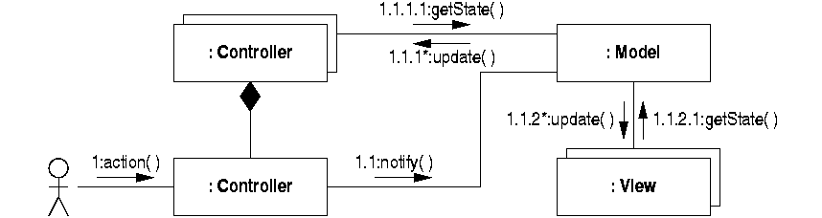
Example Interactions in MVC
User input is detected by a controller.
The model is notified.
The views are updated.
CPSC-4360-01, CPSC-5360-01, Lecture 8

Slide 42
MVC: Model
The Model
manages the behavior and data of the application domain,
responds to instructions to change state (usually from the controller), and
responds to requests for information about its state (usually from the views).
CPSC-4360-01, CPSC-5360-01, Lecture 8

Slide 43
MVC: View
The View
manages the graphical and/or textual output of the application.
provides the presentation of the model.
is the look of the application that can access the model getters, but
has no knowledge of the setters.
should be notified/updated when changes to the model occur.
CPSC-4360-01, CPSC-5360-01, Lecture 8

Slide 44
Update of view
Two simple models:
Push Model:
  The view registers itself with the model for change notifications (Observer pattern).
Pull Model:
  The view is responsible for calling the model when it needs to retrieve the most current data.
Example: Stock monitoring program
  Push Model: The view is notified whenever the stock price changes.
  Pull Model: The view access the stock price from time to time automatically.
CPSC-4360-01, CPSC-5360-01, Lecture 8

Slide 45
MVC: Controller
The Controller
reacts to the user input. It interprets the mouse and keyboard inputs from the user, commanding the model and/or the view to change as appropriate.
translates interactions with the view into actions to be performed by the model.
modifies the model.
View and Controller are specifically designed to work together. They are tightly coupled.
CPSC-4360-01, CPSC-5360-01, Lecture 8

Slide 46
Interaction within MVC
Create and Update
View
Controller
Viewed by Actor
Notify and Update
Receives Actor Events
Notify
Model
Application Data
CPSC-4360-01, CPSC-5360-01, Lecture 8
Notes:
It has to be an association from the View to the Model.
Some patterns include an indirect association from the View to the Controller, via an observer for example!
From the Model to the View, it has to be in general an indirect association.

Slide 47
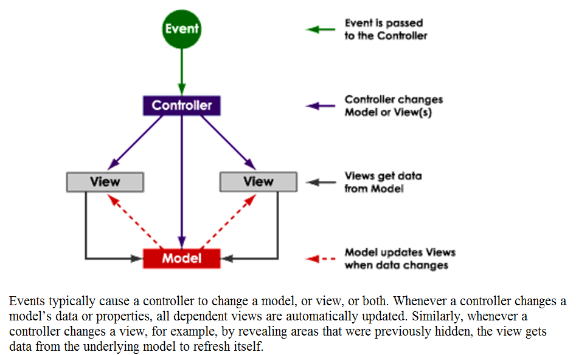
http://www.enode.com/x/markup/tutorial/mvc.html
CPSC-4360-01, CPSC-5360-01, Lecture 8

Slide 48
Observer Design Pattern
Motivation
–A common side-effect of partitioning a system into a collection of cooperating classes is the need to maintain consistency between related objects.
–How can you achieve consistency?
■Intent
–Define a one-to-many dependency between objects so that when one object changes state, all its dependents are notified and updated automatically.

Slide 49
The Observer Pattern
Context:
  A two-way association creates tight coupling between the two classes.
  Reusing or changing either of the classes will have to involve the other (when one object changes state, all its dependants are notified and updated automatically).
  On the other hand, we want to maximize the flexibility of the system to the greatest extent possible.
Problem:
  Reduce the coupling between classes, especially if they belong to different subsystems.
  Maximize the flexibility.
CPSC-4360-01, CPSC-5360-01, Lecture 8

Slide 50
The Observer Pattern
Solution:
<<Observable>>
<<Interface>>
<<Observer>>
*
*
General Idea:
addObserver( )
notifyObserver( )
update( )
<<ConcreteObservable>>
<<ConcreteObservers>>
Applied to the stock market example in MVC.
Observable
<<Interface>>
Observer
*
*
addObserver( )
notifyObserver( )
update( )
Observers are notified when a new StockPrice is ready.
StockPrice
StockPriceViewer
CPSC-4360-01, CPSC-5360-01, Lecture 8
Notes:
Since the interface only includes methods signature, it is relatively stable.
When a class is dependant on an interface, changes in those classes implementing the interface will have no impact.

Slide 51
The Observer Pattern
The <<Observable>> maintains a lists of <<Observer>>s.
  addObserver() method adds a new <<Observer>> to the list.
Whenever there is a change in the <<Observable>>, all <<Observer>>s will be notified.
  notifyObserver() method notifies all <<Observer>>s in the list.
CPSC-4360-01, CPSC-5360-01, Lecture 8

Slide 52
The Observer Pattern (cont)
<<Observer>> is an interface: any class that implements it can observe an <<Observable>>.
The dependency between the <<Observable>> classes and <<Observer>> classes is now transferred to <<Observable>> classes and the <<Observer>>s interface.
As the interface is stable, changes to the classes that implemented the interface do not affect the <<Observable>> classes.
CPSC-4360-01, CPSC-5360-01, Lecture 8

Slide 53
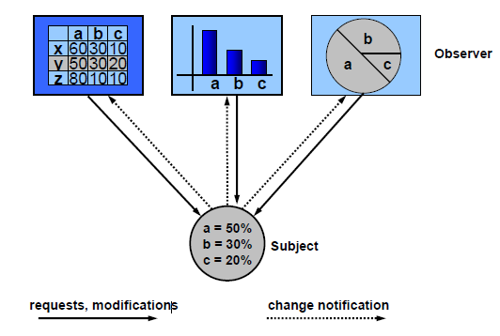

Slide 54
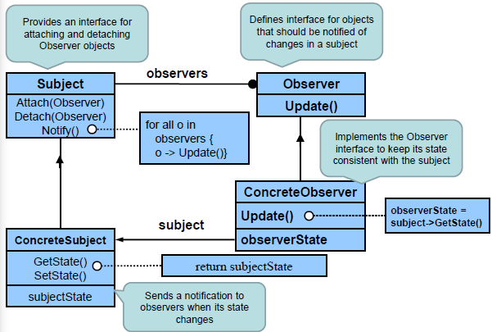

Slide 55
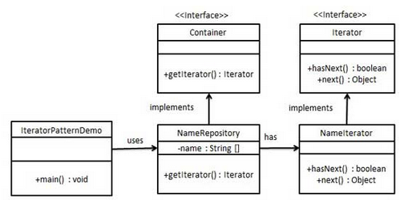
Iterator Pattern (Behavioral Design Pattern)
Commonly used pattern to get a way to access the elements of a collection object in sequential manner without any need to know its underlying representation.
Don’t want to expose implementation details of the container AND want to allow multiple simultaneous traversals

Slide 56
Iterator Pattern
Motivation
–Don’t want to expose implementation details of the container AND want to allow multiple simultaneous traversals
•Create separate interface/class that provide simple “hooks”
–Often we want to say to a container (e.g., tree, graph, table, list, graphics):
•Apply f() to each of your objects
Intent
–Provide a clean, abstract way to access all of the elements in an aggregate (container) without exposing the underlying representation
–Move responsibility for access and traversal to a separate “iterator” object

Slide 57
Design Pattern: Advices
Before applying a design pattern, make sure that:
  It is relevant to your problem, not just superficial similarity.
  You have studied the tradeoff, sometime a design pattern is not appropriate.
Applying a design pattern implies a change in the overall design and coding.
  Make sure your final system follows through.
CPSC-4360-01, CPSC-5360-01, Lecture 8

